Slide 1
Technical communication (TC) 技术传播与写作
Memo writing

Slide 2
Contents:
Warm-up
Tasks

Slide 3
Warm-up
What is memo?
Memos are hard-copy correspondence written within the company.

Slide 4
Why memo?
Documentation—expenses, incidents, accidents, problems encountered, costs, study findings, hiring, firings and reallocations of staff or equipment.
Confirmation—a meeting agenda, date, time, and location; decision to purchase or sell
Procedure—how to set up accounts, research on the company intranet, operate new machinery, use new software, etc.
Recommendations, feasibility, status, inquiry and cover, etc.

Slide 5
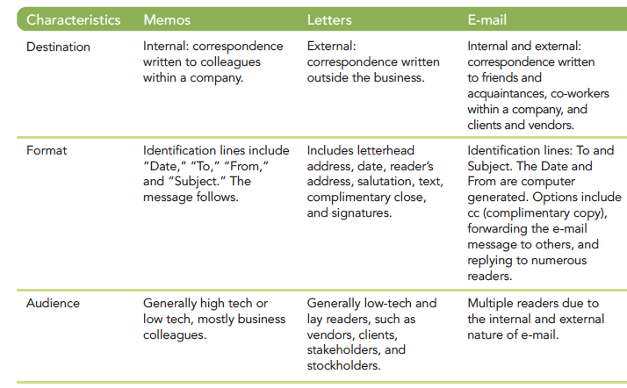
Differences among memos, letters and E-mails
Memo vs. email

Slide 6
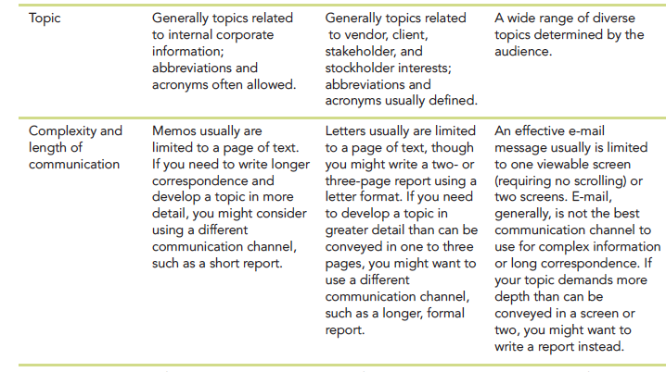

Slide 7
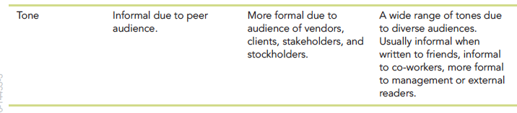
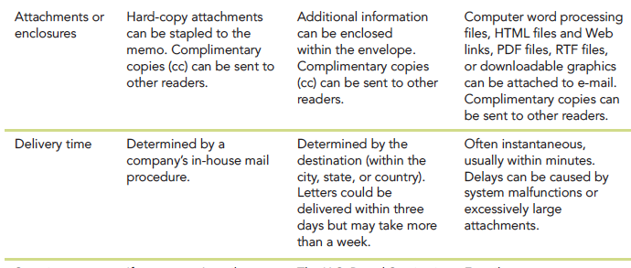
Not too informal , Moderately formal

Slide 8
Group discussion
What are the key components of a memo? (see the word file)
Memo identification lines (Subject line should be specific)
Introduction (clear statement of purpose)
Summary (main idea; request for meeting)
Discussion (details about the message, background, i.e., two out of 500 models)
Conclusion (should only consider the external drive)
Recommendation (statement of what the reader should do next)

Slide 9
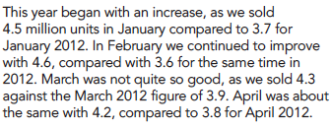
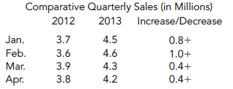
Task 1：Sample memos and revision
Before | After
Subject：sales
Report on quarterly sales

Slide 10


Before | After

Slide 11
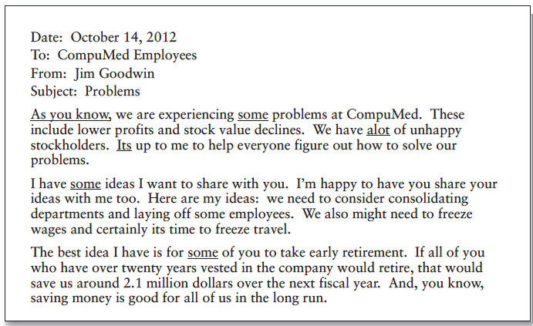
Task 2 Sample memo and revision

Slide 12

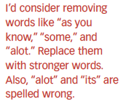
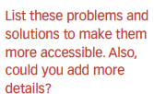
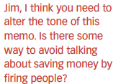

Slide 13
